Slide 2
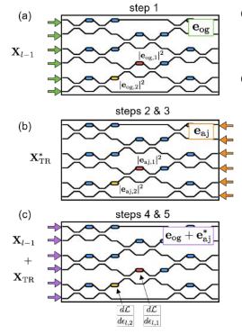
Shanhui Fan et al., “In-situ Backpropagation in Photonic Neural Networks”, Frontiers in Optics/ Laser Science, 2018.
Schematic illustration of the proposed method for experimental measurement of gradient information within an optical interference unit; (a): forward pass; (b): backpropagation of the error signal; (c): interference measurement to recover the gradient of the objective function with respect to all degrees of freedom simultaneously.

